Slide 1
Global and Regional Planning for AIM Transition
Len Wicks
Regional Officer, Air Traffic Management, International Civil Aviation Organization (ICAO)
Update, November 2015

Slide 2
Contents
APANPIRG
Asia/Pacific AIM
ASEAN
Planning
Reporting, Monitoring, Updates
Conclusions

Slide 3
APANPIRG
APANPIRG
Air Traffic Management
Sub-Group
(ATM/SG)
Regional Aviation Safety Monitoring Advisory Group (RASMAG)
Communications, Navigation and Surveillance Sub-Group (CNS/SG)
Aerodrome Operations Sub-Group
(AOP/SG)
Aviation Meteorology Sub-Group
(MET/SG)
AIS/AIM Implementation Task Force
AAITF
Air Traffic Flow Management Steering Group
ATFM/SG
Regional ATM Contingency Plan Task Force
RACP/TF
Asia/Pacific Search and Rescue Task Force
APSAR/WG
South Asia/Indian Ocean ATS Coordination Group
SAIOCG
South East Asia ATM Coordination Group
SEACG

Slide 4
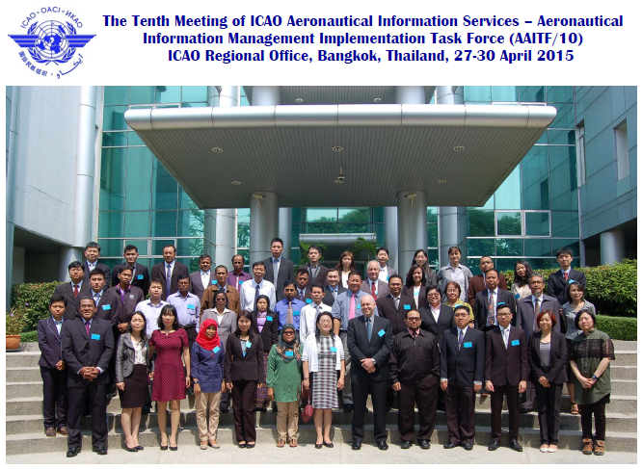
APANPIRG

Slide 5
APANPIRG
Meeting Reports available on ICAO Asia/Pacific Regional Office website:
http://www.icao.int/APAC/Meetings/Pages/default.aspx
Current Regional Status: AIS – AIM Transition
http://www.icao.int/APAC/Documents/edocs/AIS%20AIM%20Implementation%20Table.pdf

Slide 6
Asia/Pacific AIM
Guidance Manual for AIS in the Asia/Pacific Region:
http://www.icao.int/APAC/Documents/edocs/AIS_GM.pdf
  Includes:
  Chapter 1 – AIS Quality Systems
  Chapter 2 – Selection and Training Guidelines for AIS
  Chapter 3 – Operating Procedures for AIS Dynamic Data (OPADD)

Slide 7
Asia/Pacific AIM
Guidance Manual for AIS in the Asia/Pacific Region:
Updated by AAITF/10
  New Appendix: Interim AIM Transition Guidance
    Delayed delivery of global guidance documents
    Regionally developed guidance for four priority steps from AIM transition roadmap

Slide 8
Asia/Pacific AIM
ICAO Roadmap for the Transition from AIS to AIM
Phase 1 – Consolidation
  Expected by November 2010 (Compliance with existing SARPS)
Phase 2 – Going Digital
  Expected by November 2013 (New SARPS Annex 15 Amendment 37)
Phase 3 – Information Management
  Expected by November 2016

Slide 9
Asia/Pacific AIM
Guidance Manual for AIS in the Asia/Pacific Region:
Updated by AAITF/10 – adopted by APANPIRG/26 (Sep 2015)
  New Appendix: Interim AIM Transition Guidance
    P-17 – Quality (Phase 1)
    P-11 – Electronic AIP (Phase 2)
    P-16 – Training (Phase 3)
    P-18 – Agreements with data originators (Phase 3)

Slide 10
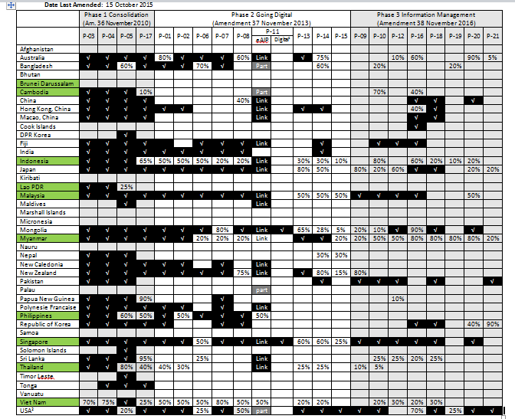
Asia/Pacific AIM
Phase 1 – November 2010
P-03 — AIRAC adherence monitoring
P-04 — Monitoring of States’ differences to Annex 4/15
P-05 — WGS-84 implementation
P-17 — Quality
Phase 2 – November 2013
P-01 — Data quality monitoring
P-02 — Data integrity monitoring
P-06 — Integrated aeronautical information database
P-07 — Unique identifiers
P-08 — Aeronautical information conceptual model
P-11 — Electronic AIP
P-13 — Terrain
P-14 — Obstacles
P-15 — Aerodrome mapping

Slide 11
Asia/Pacific AIM
Regional Progress – Phases 1, 2 and 3
(Expected Completion Nov 2016)
Phase 1 and 2 elements = 62% of all transition elements

Slide 12
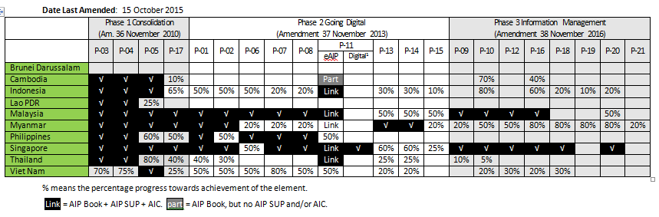
ASEAN

Slide 13
ASEAN
Phase 1 and 2 elements = 62%
Progress – All Phases
(Expected Completion Nov 2016)

Slide 14
ASEAN
Progress – Phases 1 and 2
(Expected Completion Nov 2013)

Slide 15
Planning
Administered by ICAO HQ
Hierarchy of global
and regional planning*
APAC Seamless ATM
planning is at the level
of strategy for regional
implementation
* 6 year plans
2013-2019, etc.
Global Vision
Global Air Traffic Management Operational Concept (Doc 9854)
Global Reporting
Global Air Navigation Report
Global Air Safety Report
Global Strategy
Global Air Navigation Plan (Doc 9750)
Global Aviation Safety Plan (Doc 10004)
Regional Reporting
Asia/Pacific Regional Dashboard
Administered by ICAO Regional Office
Regional Vision
Asia/Pacific Region Air Navigation Plan
(Doc 9763)
Regional Implementation Monitoring
Asia/Pacific Regional Picture
Regional Implementation Strategy
Asia/Pacific Seamless ATM Plan
(incorporated into eANP Vol. III), including:
Asia/Pacific Regional ATFM Framework
Regional ATM Contingency Plan (draft)
Asia/Pacific Search and Rescue Plan
AMS, NAV and SUR strategies
Regional Implementation Reporting
Seamless ATM Reporting
Regional Guidance Material
Seamless ATM Guidance Material
State Seamless ATM Plan Template

Slide 16
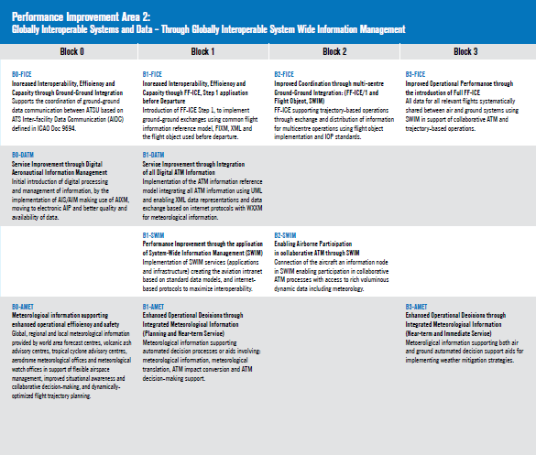
Planning
B0 – DATM
(2013 – 2018 2019)
  Initial introduction of digital processing/management of information
  Implementation of AIS/AIM using AIXM
  Electronic AIP
  Better quality and availability

Slide 17
Planning
  The transition from paper products to digital data is a critical prerequisite for the implementation of any current or future ATM or air navigation concept that relies on the accuracy, integrity and timeliness of data.
B0 – DATM
(2013 – 2018 2019)
  Initial introduction of digital processing/management of information
  Implementation of AIS/AIM using AIXM
  Electronic AIP
  Better quality and availability

Slide 18
Planning
B1 – DATM
(2019 – 2025)
  ATM information reference model integrating all ATM information
  Common formats AIXM, FIXM, WIXM and internet protocols

Slide 19
Planning
B1 – SWIM (System Wide Information Management)
(2019 – 2025)
  Implementation of SWIM applications and infrastructure
  Standard data models
  Internet-based protocols
  Maximized interoperability

Slide 20
Planning
B2 – SWIM
(2025 – 2031)
  Aircraft as a fully connected information node in SWIM
  Collaborative ATM processes – exchange of data

Slide 21
Planning
Other ASBU are Heavily Dependent on AIM
  a critical prerequisite for the implementation of any current or future ATM or air navigation concept that relies on the accuracy, integrity and timeliness of data.

Slide 22
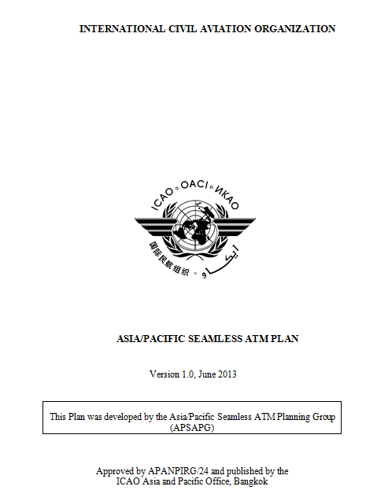
Planning
The Asia/Pacific Seamless ATM Plan incorporated
the Aviation System Block Upgrades (ASBU), but
also a significant number of human performance
and civil/military cooperation elements.
The Seamless ATM Plan is available at:
http://www.icao.int/APAC/Pages/edocs.aspx

Slide 23
Planning
ICAO guidance is
provided to assist
States with
Seamless ATM
planning
PARS or PASL
element
Objective
for Phase I
Objective
for Phase II
Project management
Areas impacted, and further guidance

Slide 24
Planning
Implementation progress
reports
ICAO SARP/
Seamless ATM Plan updates
The State Seamless ATM
Plan is a valuable means
of keeping stakeholders
informed and for planners
to see the big picture
Plan and implement projects
National GAP analysis against SARPs/Seamless ATM Plan
State
Seamless Plan strategy update

Slide 25
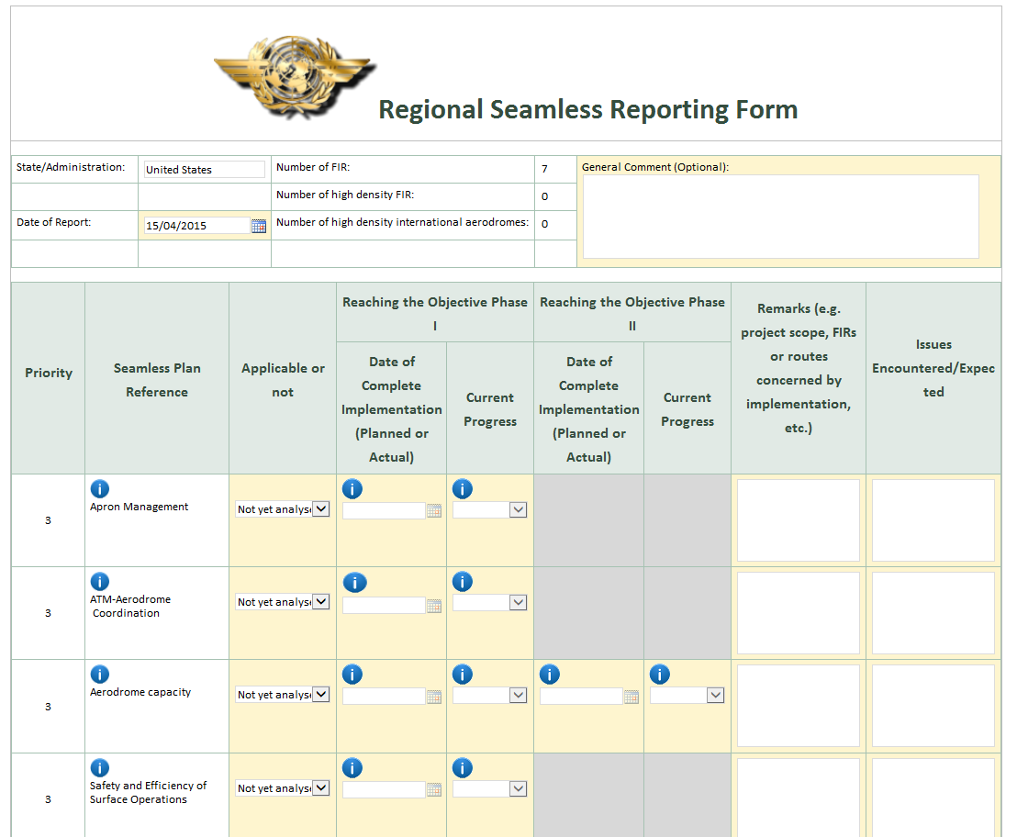
Reporting, Monitoring, Updates
The Seamless ATM
Reporting and Monitoring
System is Internet-based,
using a simple form

Slide 26
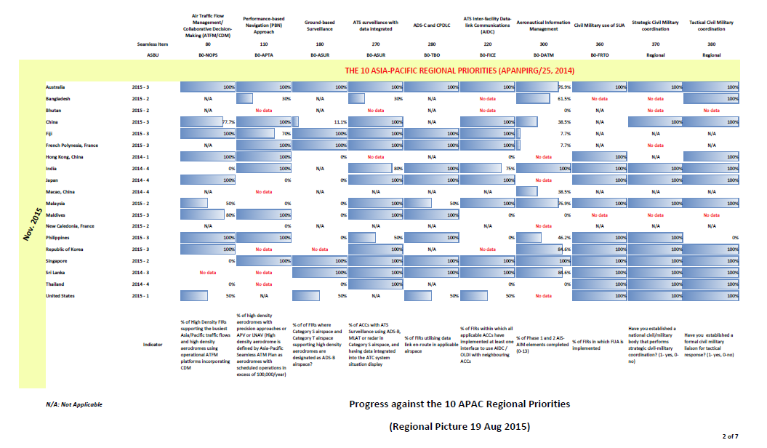
Reporting, Monitoring, Updates
The data supports:
  analysis by
  APANPIRG
  a regional picture
  feedback to ICAO
  HQ on ASBU

Slide 27
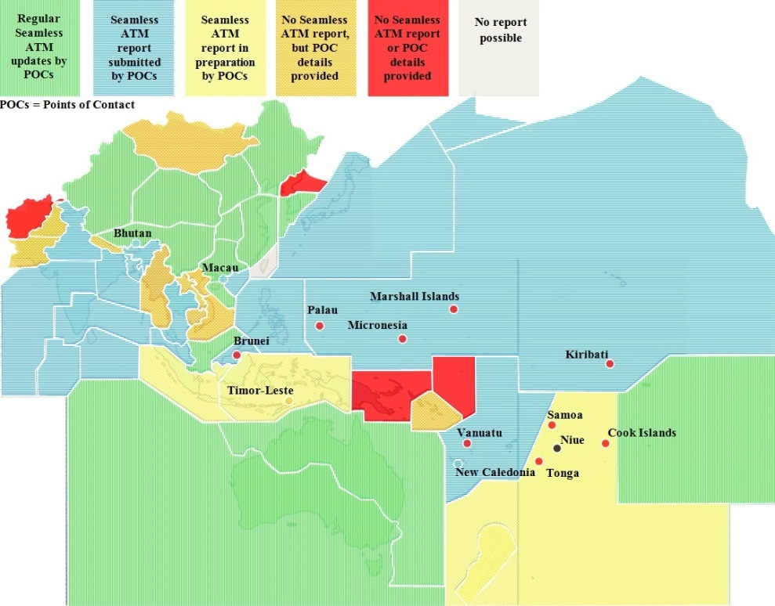
Reporting, Monitoring, Updates
As at 01 October 2015, 19 Asia/Pacific administrations (44%), had submitted a Seamless ATM report.

Slide 28
Reporting, Monitoring, Updates
As at 01 October 2015, 23 States had not submitted Seamless ATM reports:
  Afghanistan, Brunei Darussalam, Cambodia, Cook Islands, DPR Korea, Indonesia*, Lao PDR, Marshall Islands, Micronesia, Mongolia, Myanmar, Nauru, Nepal, New Zealand*, Pakistan, Palau, Papua New Guinea, Samoa, Solomon Islands, Timor-Leste, Tonga, Vanuatu, and Viet Nam
  (*the report was being prepared).

Slide 29
Reporting, Monitoring, Updates
As at 01 October 2015, 12 States had not submitted the nomination of their Seamless ATM Points of Contact (POCs):
  Afghanistan, Brunei Darussalam, Cook Islands, DPR Korea, Kiribati, Marshall Islands, Micronesia, Nauru, Palau, Papua New Guinea, Samoa, and Tonga.

Slide 30
Reporting, Monitoring, Updates
The initial data indicates that States which have reported are:
  on target for Phase 1 B0-FRTO and civil/military regional elements (however this needs verification as issues remain)
  partially on target for B0-NOPS (ATFM), B0-TBO (ADS-C/CPDLC), B0-APTA (PBN approaches) and B0-FICE (AIDC)
  generally not on target for B0-ASUR (ground-based surveillance) and B0-AIM (Aeronautical Information Management)

Slide 31
Reporting, Monitoring, Updates
The Seamless ATM Plan has a three year update cycle
  Early consultation had commenced with a State Letter circulating a marked-up version on the Plan including corrections, omissions added and possible new items noted
  Block 1 ASBU elements will be considered

Slide 32
Reporting, Monitoring, Updates
The Seamless ATM Plan V1.1 draft is available at on the ICAO APAC website under ‘Meetings’ ‘ATM/SG/3’ at:
  http://www.icao.int/APAC/Meetings/2015%20ATMSG3/Asia%20Pacific%20Seamless%20ATM%20Plan%20V1.1%20MASTER%20MARK%20UP%2029%20September%202015.doc

Slide 33
Reporting, Monitoring, Updates
ICAO is considering the development of a new Asia/Pacific Plan for Collaborative AIM (Aeronautical Information Management) to support the Seamless ATM Plan
Seamless ATM will become an integral part of the eANP (Vol III) in 2016

Slide 34
Conclusions
The Asia/Pacific Seamless ATM Plan is now a key part of APANPIRG’s planning, but also assists the RASG
Asia/Pacific States (especially in ASEAN) are lagging behind key implementation expectations, particularly in AIM transition

